Slide 1
SyteLine Heavy Equipment Rental & Service Industry Pack
Sales & Marketing Kit

Slide 2
Full Disclaimer
This information reflects the direction QuadKor/Infor® may take with regard to the products or services described herein, all of which is subject to change without notice. This information is not a commitment to you in any way and you should not rely on any content herein in making any decision. QuadKor/Infor is not committing to develop or deliver any specified enhancement, upgrade, product, service or functionality, even if such is described herein. Many factors can affect Infor’s product development plans and the nature, content and timing of future product releases, all of which remain in the sole discretion of QuadKor/Infor. This information, in whole or in part, may not be incorporated into any agreement. QuadKor/Infor expressly disclaims any liability with respect to this presentation.

Slide 3
Table of Contents
History
Market
Competition
Sales Approach
Sales Support Calendar
Training
Marketing Kit
Press release announcing additional native functionality in SyteLine
Net new brochure – brandable
Install base brochure - brandable
On-demand demo
2-minute teaser video
Updated Infor SyteLine Functionality List Summary
Equipment Rental Resources

Slide 4
History
As an equipment rental and field service expert, QuadKor
Recognized need for rental functionality to win equipment rental and field service deals
Introduced rental functionality 2017 with one of the largest ISM deals
Built deep rental functionality extension for on-prem ISM in 2017 - converted to CSFS multi-tenant cloud in 2019
ISM stand-alone SKU no longer sellable as of Nov 2020 (rental functionality added to SX.e)
Decided in early 2021 to develop the equipment rental and advanced field service functionality for SyteLine

Slide 5
Introducing… SyteLine Heavy Equipment Rental & Service Industry Pack
May 2021 – New direction, wrote equipment rental and advanced field service functionality to SyteLine
An all-in-one solution for this untapped market

Slide 6
Infor SyteLine with Field Service
Infor Service Management
Infor SyteLine Equipment Rental & Service
Coming soon

Slide 7
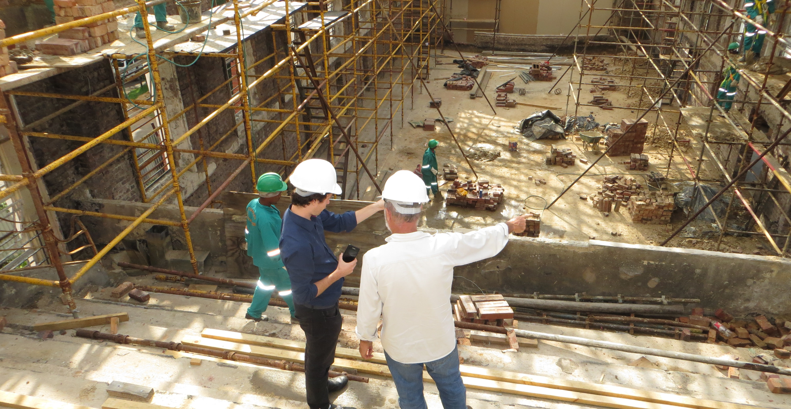
Added Value Sectors
Construction
Field Service
Equipment Rental

Slide 8
The Market (Macro-level) - $5M to $250M
1.0x
0.3x
1.6x
2.8x
5.0x
2022
2026
1.1x
0.3x
2.0x
3.2x
6.4x
Discreet Manufacturing
Process Manufacturing
Equipment Service
Equipment Rental
Construction

Slide 9
Target
1.0x
0.3x
1.6x
2.8x
5.0x
2022
2026
1.1x
0.3x
2.0x
3.2x
6.4x
Discreet Manufacturing
Process Manufacturing
Equipment Service
Equipment Rental
Construction

Slide 10
Heavy Equipment Rental Target Market
US Forecast
2021 Revenue
2022
2023
2026
$45.8 bn
$55.9 bn
11.2%
$59 bn
$65.1 bn
Record over pre-COVID
American Rental Association, 08/03/2022

Slide 11
Construction Target Market
US Forecast
2021 Revenue
2022
2025
2030
$6.4 tn
$8.2 tn
$10.3 tn
$14.4 tn
Statistica Research Department, 07/05/2022

Slide 12
Field Service Target Market
US Forecast
2021 Revenue
2022
2025
2030
$3 bn
$4.8 bn
$5.1 bn
$24.3 bn
Allied Market Research, 2021
ReachOut, 2020

Slide 13
…Not Just For Heavy Equipment Rentals
Medical Device
Industrial Equipment
Construction
Manufacturing
SyteLine Equipment Rental & Service
High Tech
Small Equipment

Slide 14
…Construction Segments
Industrial
Commercial
Infrastructure
Residential
SyteLine Equipment Rental & Service
Institutional
Energy/Utilities
Engineering

Slide 15
…Field Service Users
Healthcare/Life Sciences
IT/Telecom
Building Management
Manufacturing
SyteLine Equipment Rental & Service
Oil/Gas/Energy/Utilities
Transportation

Slide 16
Competition
Mostly legacy on-prem without funding to go MT cloud
Predominantly partner extensions of MS Dynamics legacy on-prem
Lots of new start-ups in MT cloud
Point solutions requiring finance integration to QuickBooks or Dynamics accounting packages
Getting stronger, established/recognized industry names
Expensive

Slide 17
Sales Approach
80/20 Rule
Current/ Future Deals
Vertical
Low hanging fruit
Customers in your backyard
Working deals with a need
Selling to the rental and construction markets

Slide 18
Sales
Demos for Existing Customers
20 min – Discovery
30 min – Demo
Demos for Rental Companies
30 min - Discovery
60 min – Demo
Feature Key Requests
ChristinaM@quadkor.com

Slide 19
Training
BDRs/Sales
Scripts
Email and social media content (as developed)
Detailed overview of industry pack
Solution Consultants
In-depth training

Slide 20
Sales Scripts
https://www.quadkor.com/wp-content/uploads/2022/06/Rental-Service-BDR-Scripts-060222.xlsx

Slide 21
Marketing Kit
All the tools you need to sell the Heavy Equipment Rental & Service Pack
Press release announcing additional native functionality in SyteLine
Net new brochure – brandable
Client facing brochure - brandable
On-demand demo
4-minute teaser video
Updated Infor SyteLine Functionality List Summary

Slide 22
Press Release
https://www.quadkor.com/wp-content/uploads/2022/06/Partner-RentalERP_PR.docx
<<Date>> Finally - An End-to-End Business Solution Now Available to Rental Industry
<<City, State>>, -- <<Company Name>>, an Infor Channel Partner, today announced they are offering a breakthrough ERP system designed specifically for the Heavy Equipment Rental Industry.
Infor® SyteLine Equipment Rental and Service Industry ERP is a fully functional, end-to-end system, delivered in a modern, simple user interface with all the equipment rental functionality you can think of.
<Company Name>>’s equipment rental customers craved precise functionality at their fingertips, such as Easy Quote Comparison with logical Financial Management, Increased Growth and Revenue Opportunities through seamless Work Order Management, Detailed Inventory Management to stay current when creating a quote, and more, to get ahead in this highly competitive market.
By modernizing their business with Infor SyteLine Equipment Rental ERP, a cloud-based, rental-focused ERP solution, equipment rental companies can focus on growth, customer engagement, and extended services. SyteLine Equipment Rental ERP gives rental companies the flexibility and scalability to excel at their current market, take on new markets and/or quickly adapt to change with deep, proven capabilities to support all business processes—not just rental.
Equipment rental companies can learn more about Infor Syteline Equipment Rental ERP at <<Company URL>>.
###
About <<Company Name>>
About Infor®
Infor is a global leader in business cloud software specialized by industry. Infor develops complete solutions for their focused industries, including industrial manufacturing, distribution, healthcare, food and beverage, automotive, aerospace and defense, and high tech. Infor’s mission-critical enterprise applications and services are designed to deliver sustainable operational advantages with security and faster time to value. Infor delivers successful business outcomes for customers. Over 65,000 organizations in more than 175 countries rely on Infor’s 17,000 employees to help achieve their business goals. As a Koch company, Infor’s financial strength, ownership structure, and long-term view empower Infor to foster enduring, mutually beneficial relationships with their customers.

Slide 23
Net New Brochure
https://www.quadkor.com/wp-content/uploads/2022/06/Infor-Syteline-Equipment-Rental-Service-ERP-Brochure.pdf

Slide 24
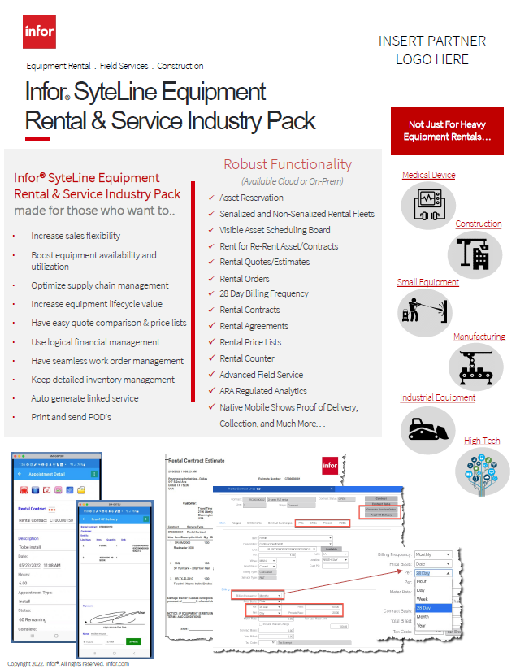
Install Base Brochure
https://www.quadkor.com/wp-content/uploads/2022/07/SyteLine-Equipment-Rental-Service-Industry-Pack-Install-Base-Brochure.pdf

Slide 25
Demos
On-demand demo video
https://vimeo.com/679237842 (46 minutes)
4-minute video
https://vimeo.com/720501940 (4.5 minutes)

Slide 26
SyteLine Functionality Summary
https://www.quadkor.com/wp-content/uploads/2022/05/Infor-CloudSuite-Industrial-Functionality-List-Summary-Cloud-0222.pdf

Slide 27
Equipment Rental Associations & Resources
American Rental Association – www.ararental.org
Associated Equipment Distributors - www.aednet.org/about/industries-we-serve/rental
Equipment Today - www.forconstructionpros.com/equipment
Rental Equipment Register - www.rermag.com/associations
RentalWATCH - www.forconstructionpros.com/rental
Statista - www.statista.com/statistics/248725/us-equipment-rental-market-size/

Slide 28
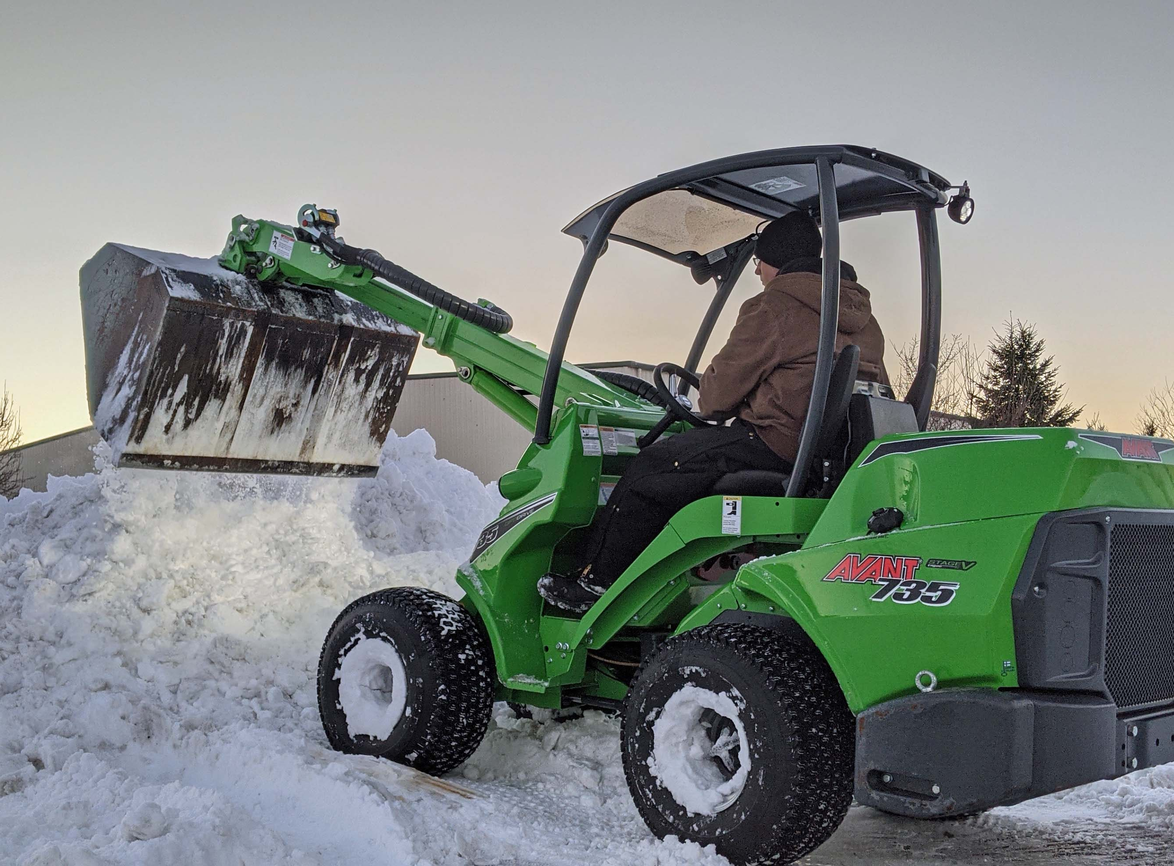
Ready to get started?
Sales
Laryssa Hauswald, lhauswald@quadkor.com
619-246-8305
Marketing
Rochelle Paulet, rpaulet@quadkor.com
303-416-0032
Schedule Demos/Request Feature Keys
Christina Martinez, christinam@quadkor.com
619-213-3171
Implementation
Sam Yaz, syaz@quadkor.com
858-752-0967
System Architect
Garry Moyle, gmoyle@quadkor.com
619-240-4092
Wish to see the Rental Pack in action? We can show you Now if you have time.

